Slide 1

MELODY APP
A HIGHLY FUNCTIONAL ATTRACTIVE MUSIC APPLICATION only meant to soothe your ears .
-BY TEAM NO. 3

Slide 2
TEAM MEMBERS AND INDIVIDUAL CONTRIBUTION
NAME | EMPLOYEE ID | CONTRIBUTION
INDRANIL PAUL (SCRUM MASTER) | 11607040 | CREATION OF LOGIN AND REGISTRATION PAGE CREATION OF OFFLINE MUSIC PLAYABLE FEATURE
INDRANI BARDHAN | 11607039 | FETCHING OF DATA FROM NAPSTER API AND CREATION OF PLAYLIST FEATURE CRUD OPERATION ON ALBUM TRACKS
P. SAI KIRAN | 11607346 | DASHBOARD CREATION
B.CHANDU PRIYANKA | 11607026 | USER BIO CRUD OPERATION

Slide 3

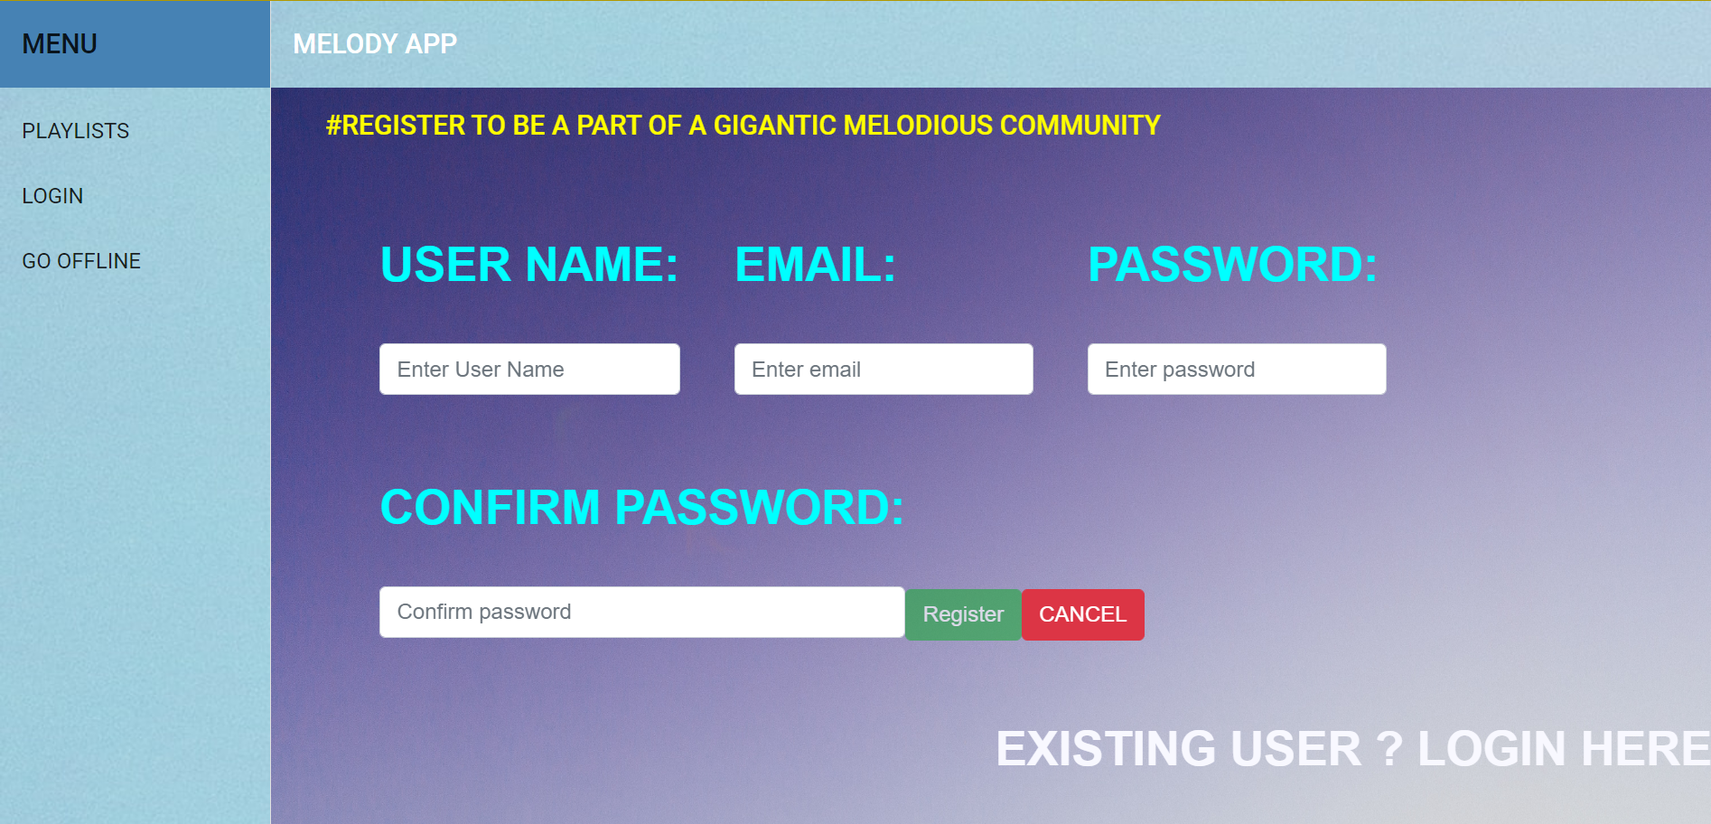
REGISTRATION PAGE
FEATURES :
REGISTRATION USING 6 DIGIT PASSWORD ENTRY .
VALID EMAIL ID IS NEEDED TO REGISTER.

Slide 4
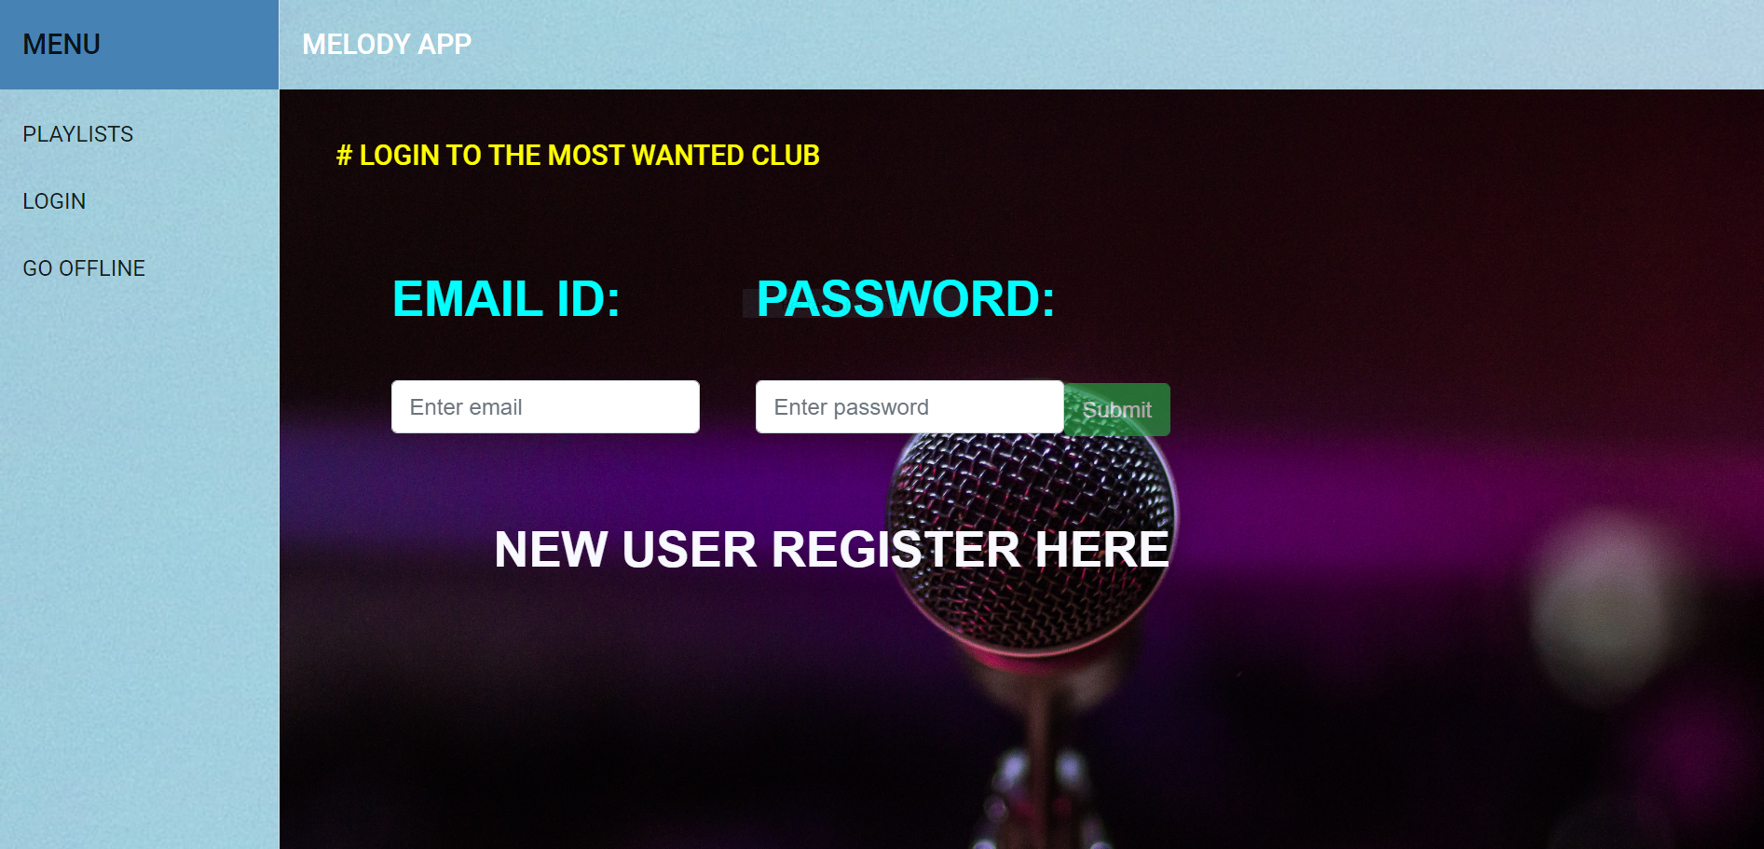
LOGIN PAGE
FEATURES :-
SIMPLE LOGIN FUNCTION USING AUTHENTICATION.

Slide 5
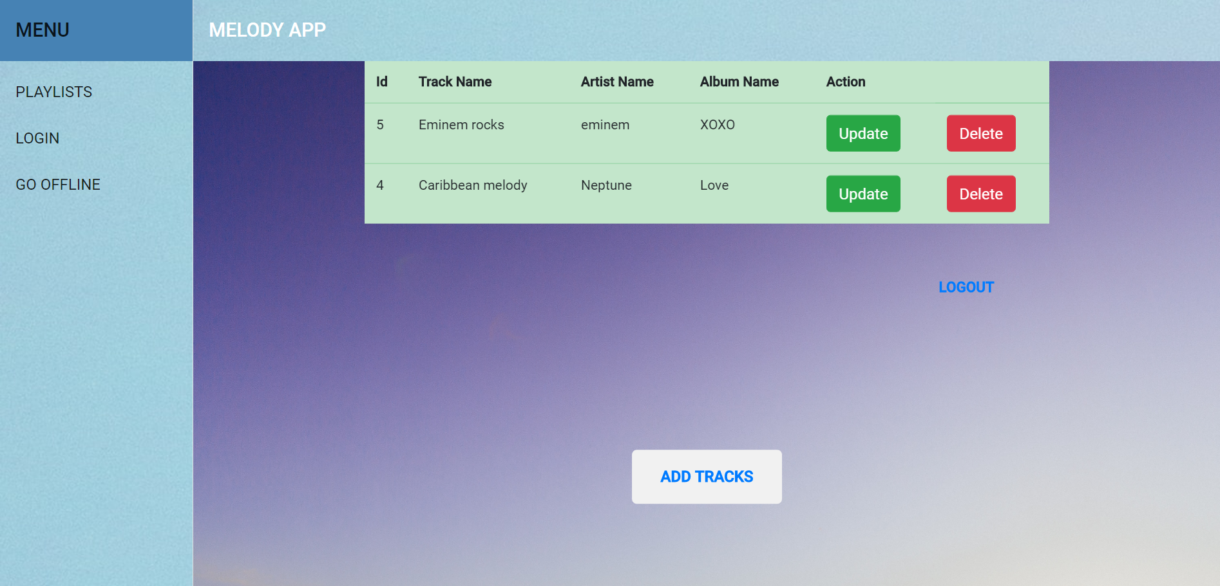
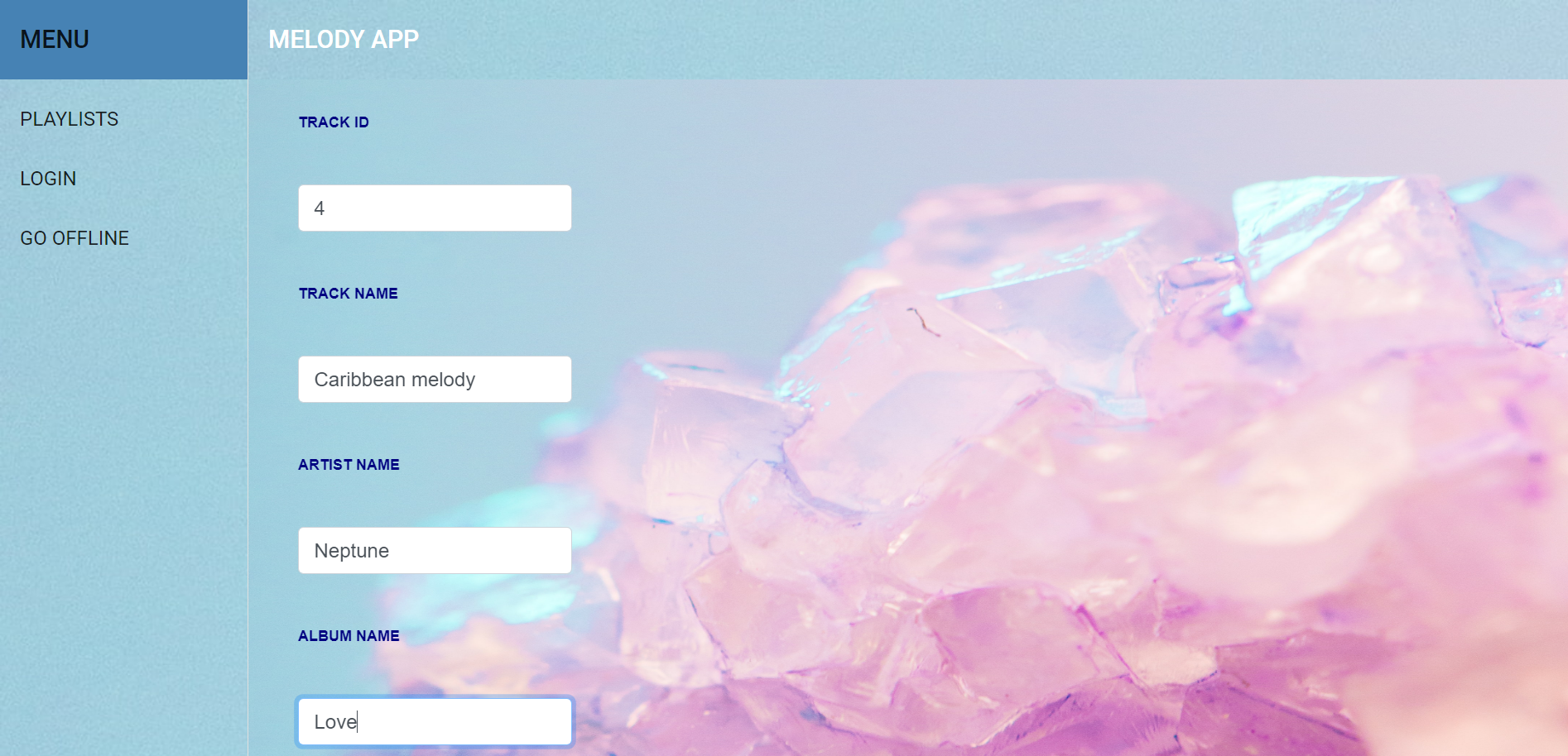
TRACKS

Slide 6
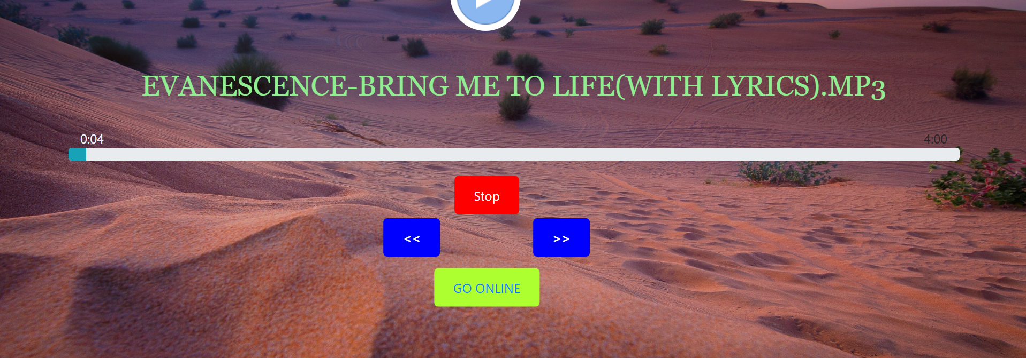
OFFLINE MUSIC FEATURE
FEATURE :-
CAN PLAY MUSIC STORED LOCALLY
NO INTERNET CONNECTION REQUIRED

Slide 7

THANK YOU

